Slide 1

PlayerData Internship Presentation
Eden Léonnet-Creasey
Notes:
Eden

Slide 2
How I approached the task
Inspected the data through the use of different visualisations
Considered different ways to remove noise and clean the data; experimented with options and implemented those that worked best
Decided upon the zones to split the pitch into
Identified high intensity periods and classified these
Researched different metrics that could be looked at and implemented the one I chose to use
Details on key elements follow.

Slide 3
Cleaning the data

Slide 4
Removing Noise- Options Considered
Kalman Filter:
Approximates the true data by combining sensor data with the results of a model. Can be finely tuned for very good accuracy.
While it likely would have had the greatest effect at reducing noise, the requirement of a reliable human movement model rendered it unfeasible to implement.
Median Filtered + Exponential Moving Average (EMA):
Used together, a median filter reduces the impact of large spikes, whilst EMA reduces high frequency noise.
Required a trade off when handling both noisy and non-noisy data – I had to choose between either smoothing noisy data not enough, or over-smoothing non-noisy data.
Fourier Transform:
Approximates movement using a combination of sin and cosine waves.
It reduced noise well, but struggled to represent non-noisy data or handle large gaps in information
Wavelet Transformation:
Uses a wavelet function to decompose a signal into different frequency components before reconstructing it with reduced noise.
It was able to handle noisy data while maintaining the form of non noisy data particularly well. Hence, I opted to use it for this for the task.

Slide 5
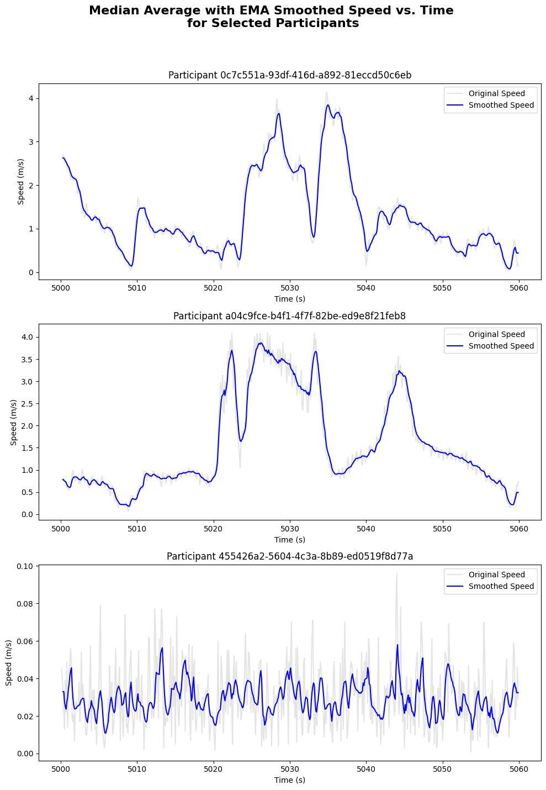
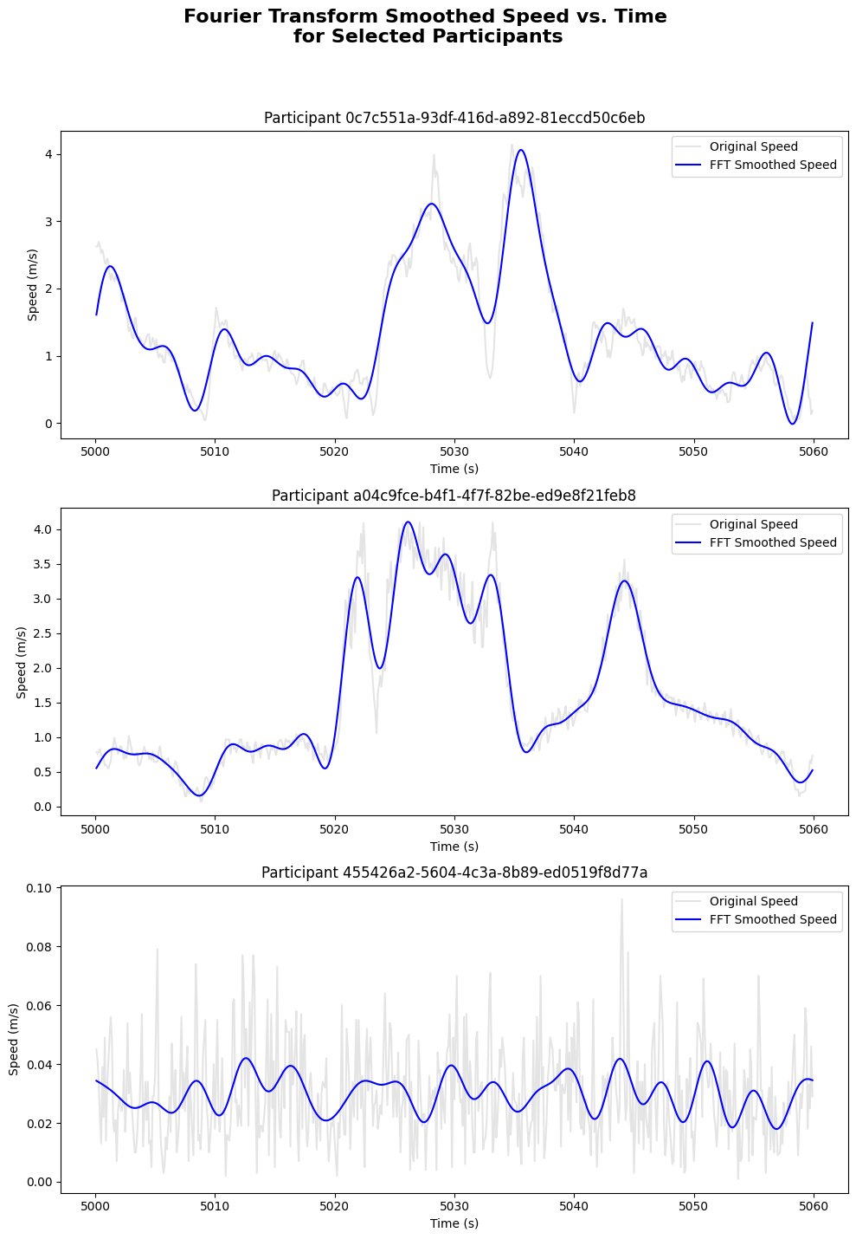
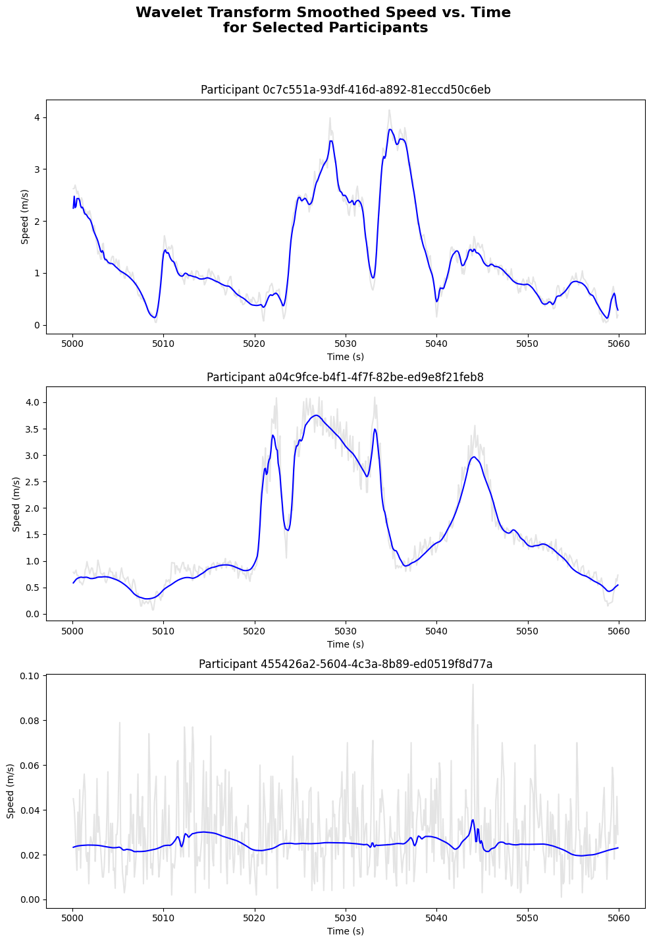

Slide 6
Further Cleaning
Removed all data outside of human movement limits.
Removed any points where acceleration was greater than 9.5m/s², the world record for human acceleration set by Usain bolt.
Also removed any points where the change in position indicating a speed greater than that achieved by any footballer – Micky Van De Ven in the 23/24 season at 10.38m/s.
Removed Data from half time and multiplied the position x and y values for the second half by -1 to preserve positioning between halves.
Also removed any data outside of the pitch limits
https://www.science.org/content/article/scienceshot-physics-usain-bolt
https://www.premierleague.com/news/3884168

Slide 7
Splitting the pitch into zones

Slide 8
Splitting the pitch
I split the pitch into nine zones -
Lengthways:
Split the pitch into thirds – Attacking, Middle and Defensive
Widthways:
Split the pitch into three areas - Central and Left/Right Wide
Central area composed of the central and half spaces – from one side of the penalty box to the other.
Wide areas composed of the Wing areas
Why not include the half spaces as their own zones? I didn’t want to dilute the data.

Slide 9
High Intensity Periods

Slide 10
Determining High Intensity Periods
I defined whenever a player was at a high intensity based upon their speed.
Set each block of these a unique ID.
If any of these blocks spanned over 0.5 seconds I classified them as a high intensity period, adding them to a new dataframe. I included the participant ID, duration and zones travelled throughout the period.
I created visualisations from the data.

Slide 11
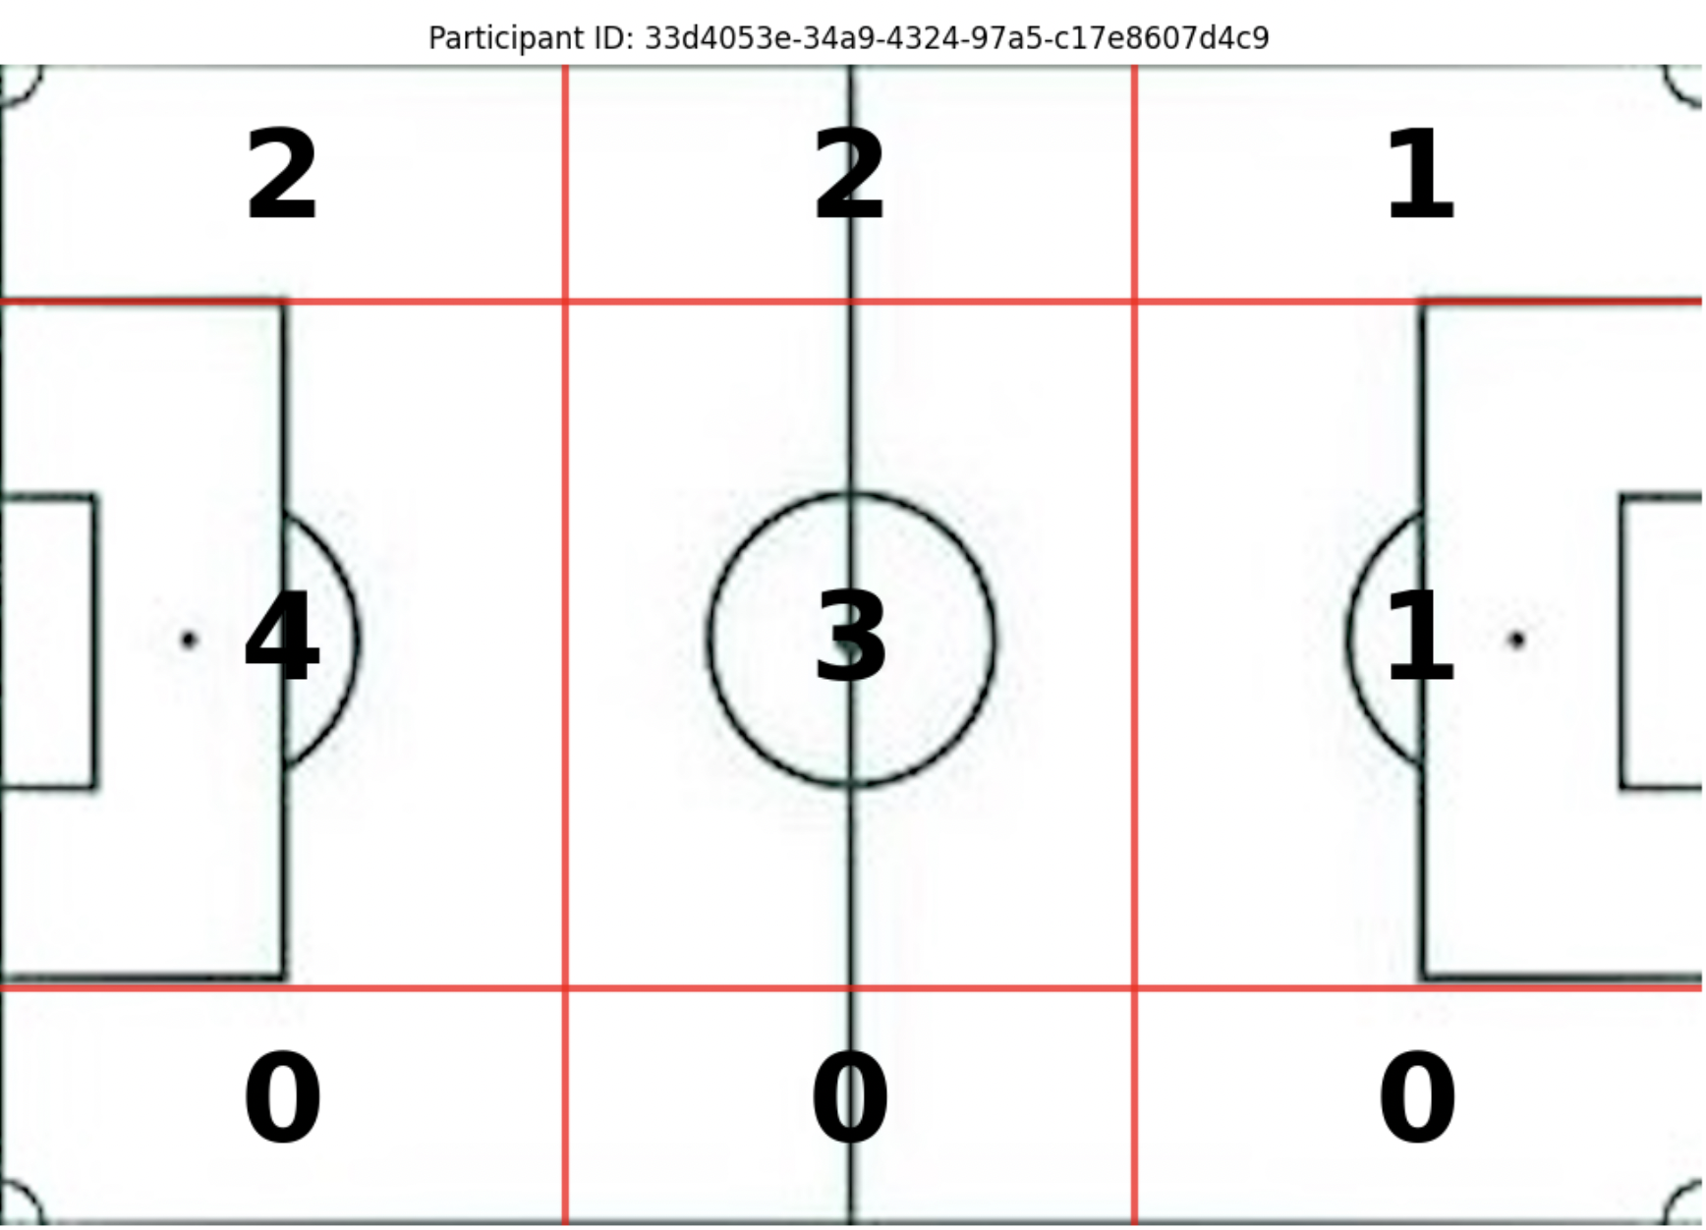
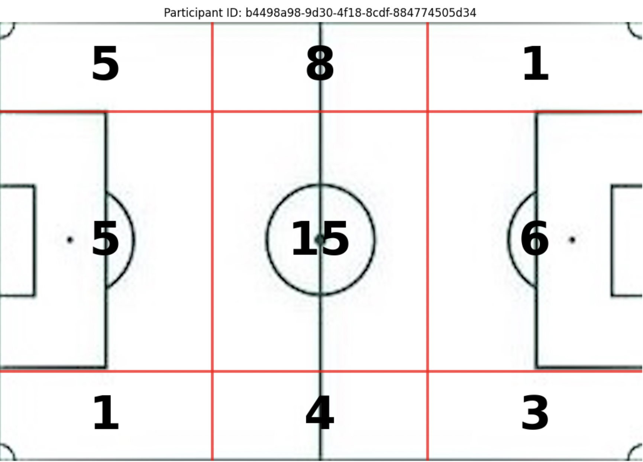
Visualisations

Slide 12
Metric – Passing Maps and Average Positions

Slide 13
Why?
I chose the metric of passes between players as:
It allows managers to analyse the roles and importance of different players in possession.
Managers can see which combinations of players are playing well together or where the roles of different players are clashing.
It would also allow them to analyse which players are most important to the team's build up, and whether certain players are struggling to get on the ball - due to either their own instructions, the opposition, or the players themselves.

Slide 14
Steps Taken to Identify this Metric
Defined possession:
Any timestep at which the closest player is within a set distance of the ball.
While this is not perfect, when combined with our passing definitions this should be effective enough.
Classified passes:
Where possession shifts from one player to another without any significant change in direction while traveling.
Used this to create a graph of passes between players
Represented this with a pass map, showing the average positions and number of passes between players.

Slide 15
